Slide 1
Sentiment Discovery and Analysis
Juno Lee 582190
Akshat Gupta 893717
Alisha Aneja 872994
Shashank Parab 897949

Slide 2
Introduction to Sentiment Discovery and Analysis
Sentiment analysis or opinion mining - computational study of people's opinions, appraisals, attitudes, and emotions toward entities, individuals, issues, events, topics etc.
Technically challenging and practically very useful.
With the explosive growth of social media (reviews, forum discussions, blogs and social networks) on the Web, individuals and organizations are increasingly using public opinions in these media for their decision making.
So the need for Sentiment Analysis.
Used in :
Businesses and organisations to find public or consumer’s opinion about products and services.
Potential consumers to know the opinions of the existing users before they use a service or purchase a product.
To keep a check on the hate tweets, blogs or posts and dangerous display of emotions online

Slide 3
Twitter Sentiment App Alec Go, Richa Bhayani, Lei Huang. 2009. Twitter Sentiment Classification using Distant Supervision

Slide 4
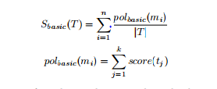
Techniques for Sentiment Analysis
UNSUPERVISED LEARNING
Lexicon based Sentiment analysis
Depends on lexical resources for mapping words to numerical sentiment score.
Different lexical resources - SentiWordNet,WordNet-Affect,MPQA,SenticNet etc.
SUPERVISED LEARNING
Machine Learning based Sentiment analysis
Better accuracy than Lexicon based Sentiment Analysis.
Uses Naïve Bayes or SVM as classification algorithm.
Different stages - Data collection, Pre-processing, Training Data, Classification, Results.
Hybrid approach to Sentiment analysis
Provides better accuracy than both Lexicon and Machine learning based Sentiment analysis.
The result obtained from Lexicon based analysis is provided as training data to the machine learning algorithm.
Eliminates too much dependency on lexical resources for accuracy.

Slide 5
Ontology based Sentiment Analysis
An Ontology can be defined as an “explicit, machine-readable specification of a shared conceptualization.” (Studer, Benjamins, & Fensel, 1998)
For Example: The screenplay was wonderful, although the acting was rather bad.
Ontologies play a key role for the development of Semantic Web, where the information is given a well defined meaning, encouraging cooperation between human users and computers.
Ontology based sentiment analysis follows the following approach which is divide in two phases.
1. Creation of the domain ontology.
2. Sentiment analysis on the set of tweets.

Slide 6
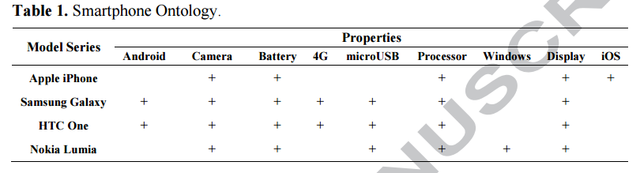
Creating the Domain Ontology
One can adopt two methods for creating the domain ontology. (Formal Concept analysis or Ontology Learning).
FCA(Formal Concept Analysis)
-It is a mathematical data analysis theory.
-it applies a user driven step by step methodology for creating domain models.
-Main building blocks are:
O is a set of formal objects
A is a set of attributes.
I is a binary Incidence relation between the objects(object o has attribute a).

Slide 7
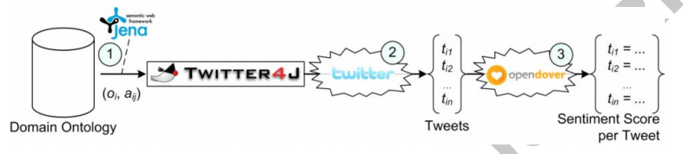
Sentiment Analysis on Tweets
The previously described process results in a formulated and populated domain ontology.
The second phase of the proposed methodology constitutes of sentiment analysis on a set of tweets.
It follows three distinct steps.
Querying the ontology for the corresponding attributes of each object.
Retrieving the relevant tweets.
Performing the sentiment analysis.

Slide 8
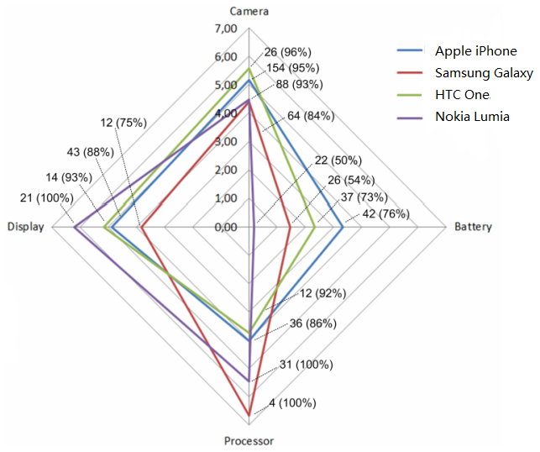
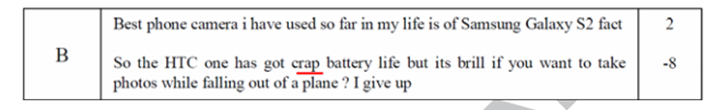
Result obtained for the case: Smartphone
The following scores are obtained based on the ontology model as described earlier.
We can analyze it at a finer level of granularity based on the attributes (Camera, Battery, Display, processor) of each object (Smartphone models).

Slide 9
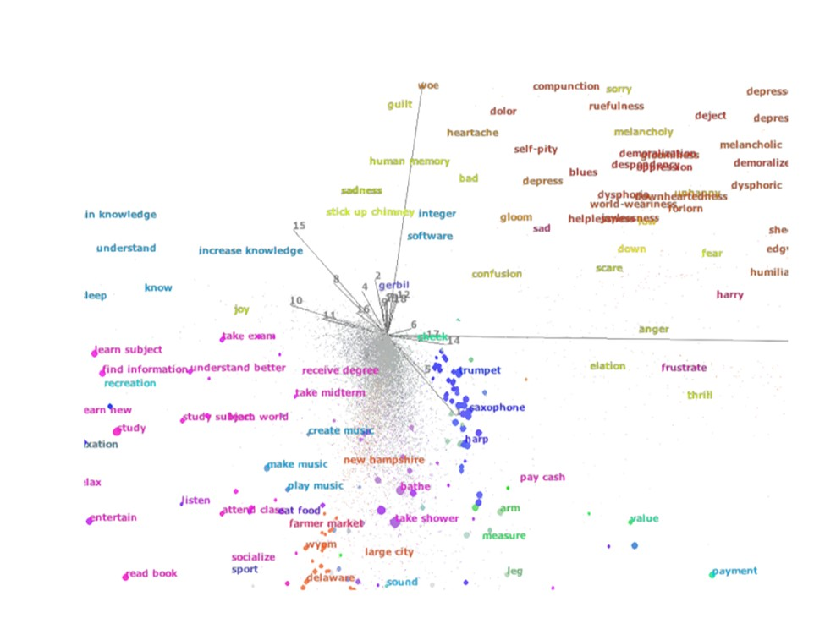
AffectiveSpace 2
Vector space model that allows concepts to be intuitively clustered according to their semantic and affective relatedness.
General framework for analogical reasoning that can be embedded in any cognitive system dealing with real-world semantics.

Slide 10
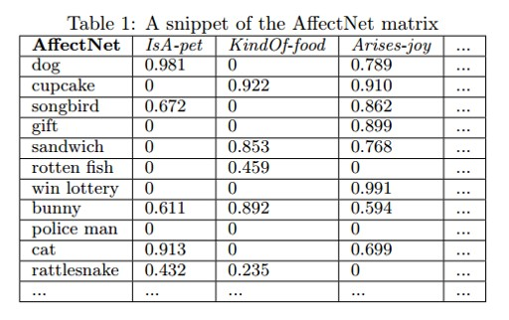
Sentic Computing Engine
Pre-Processing module
Interpret all the affective valence indicators contained in text.
Detects negation and spreads it
Split the text into single clauses.
Sentic Parser
Identifies concepts produces small bag of concepts.
Provides relative frequency, valence and status of concept.

Slide 11
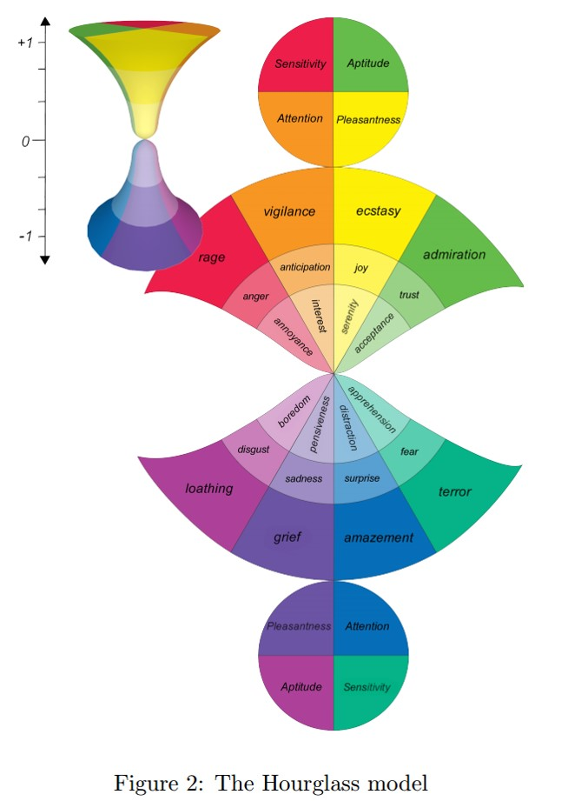
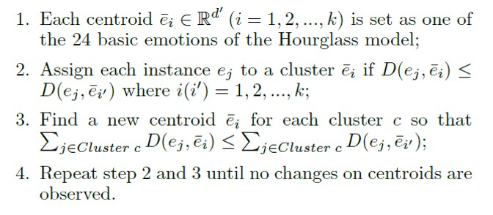
AffectiveSpace modules Clustering

Slide 12
Recent Trend in Sentiment Analysis
Increase in number of research on multimodal sentiment analysis.
Textual modality plays important role in improving the performance of an audio-visual affect detector.

Slide 13
Real Life Examples of Sentiment Analysis
ROBIN WILLIAMS SUICIDE
In 2014, fans of famous Jumanji actor, Robin Williams, abused his daughter on social media after he committed suicide
Twitter suspended accounts of people who tweeted/trolled hate comments against her
How did Twitter know who were abusing her?
Yes! By mining tweets based on Sentiment Analysis
#You are a bad daughter. He loved you but you hated him!
#You deserve to be hanged. You murderer!
FIFA WORLDCUP 2014
Chances of winning increase when people support you
Twitter and Facebook feeds used for deciding teams having maximum support based on emotions of people
More info: https://www.analyticsvidhya.com/blog/2014/07/world-cheering-2014-fifa-wc-winner-twitter/

Slide 14
Challenges to Sentiment Discovery and Analysis
Negation and modals impact affect of the text, without themselves having strong sentiment associations.
I am not at all happy with the new State Budget.
Emotions are often not explicitly stated.
Another Monday, and another week working my tail off.
Conveys a sense of frustration without overt markers.
Different degrees of affect depending on sense and context.
Mary hugged her daughter before going to work. emotional
The pipeline hugged the state border. rather unemotional

Slide 15
Challenges to Sentiment Discovery and Analysis
Difficult to interpret creative uses of language such as sarcasm, irony, humor, and metaphor/figurative language.
Congratulations! You broke my $1000 glass! sarcasm
Some texts, such as social media or literary texts, can be rife in nonstandard language:
misspellings parlament
creatively spelled words happeee
hashtagged words or similar phenomena #loveumom
abbreviations tbh, af, f9, lmao

Slide 16
Challenges to Sentiment Discovery and Analysis
Most machine learning algorithms for affect analysis require large amounts of training data
Numerous affect categories – happiness, sadness, grief, excitement
Affect categories can be overlapping
Wow, I am so happy for you! happy and excited both
Whose perspective?
• May refer to emotional events without implicitly or explicitly expressing the message producer’s view
My friend always keeps on complaining how hectic her schedule is.
frustration and complaint, but not of the speaker

Slide 17
References
Studer, R., R. Benjamins, and D. Fensel, “Knowledge Engineering: Principles and Methods”, IEEE Trans. on Data and Knowledge Eng., 25(1–2), 161–197.1998.
Kontopoulos, Efstratios, et al. "Ontology-based sentiment analysis of twitter posts.“ Expert systems with applications 40.10 (2013): 4065-4074.
E. Cambria, J. Fu, F. Bisio and S. Poria, .(2015)."AffectiveSpace 2: Enabling Affective Intuition for Concept-Level Sentiment Analysis", AAAI. pp. 1-9.
S. Poria, E. Cambria, R. Bajpai, A. Hussain. (2017). A review of affective computing: From unimodal analysis to multimodal fusion. Information fusion, 37, 98-125.
Challenges in Sentiment AnalysisSaif M. Mohammad Saif.Mohammad@nrc-cnrc.gc.ca National Research Council Canada1200 Montreal Rd., Ottawa, ON, Canada
Cataldo Musto, Giovanni Semeraro, Marco Polignano “A comparison of Lexicon-based approaches for Sentiment Analysis of microblog posts”.
R. Prabowo and M. Thelwall. Sentiment analysis: A combined approach. Journal of Informatics (2009) 143-157

